Slide 1


Predictive Maintenance for Industrial Equipment
PRASUNETHON HACKATHON
Domain: Machine Learning
Team: Smart Cube
by Shoeb Khan

Slide 2

Introduction
1
Overview of Predictive Maintenance
Predictive maintenance involves using data analysis tools to detect anomalies and predict equipment failures before they occur.
2
Importance
Reduces downtime, maintenance costs, and improves operational efficiency.
3
Problem Statement
Develop a model predicting equipment failures to schedule maintenance and reduce downtime.

Slide 3

Data Overview
Dataset Description
Information on various industrial equipment and their performance metrics.
Data Source
Data is Collected from Kaggle Datasets.
Key Features
Date, Device, Model, Various Metrics, Failure Status

Slide 4
Exploratory Data Analysis (EDA)
1
Initial Data Inspection
Shape, Description, Info
2
Handling Missing Values and Duplicates
No missing values, duplicates removed
3
Feature Engineering
Date Formatting: Convert date to datetime
Extracting Month and Weekday: Added 'month' and 'week_day' features
4
Device and Device Model Analysis
Value counts for devices and models
5
Failure Distribution
Distribution of failure status

Slide 5
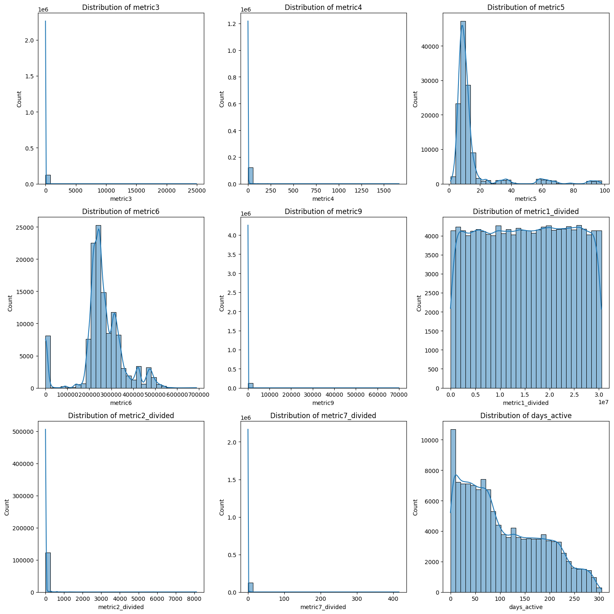
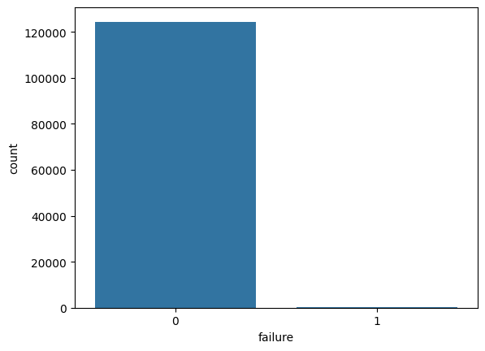
Data Visualization
Distribution of Metrics
Countplot of Failure
Analysis of metric distributions
Visual representation of failure counts

Slide 6

Feature Engineering
1
Creating New Features
Extracting relevant features from existing data
2
Handling Special Cases
Ensuring values are consistent and formatted correctly

Slide 7






Model Development
Model Selection
Evaluating various models (e.g., Logistic Regression, Random Forest)
Undersampling
Undersampling imbalance data
Training And Testing Split
Split dataset into training and testing sets
Model Trainig
Implementing pipeline to train the models
Hyperparameter Tunning
Changing Hyperparamters to find the optimum value
Performance Metrics
Confusion Matrix: True positives, false positives, true negatives, and false negatives
Cross-Validation Accuracy: Mean and standard deviation of cross-validation accuracy

Slide 8

Results
Model
ROC AUC
AUPRC
Accuracy
Cross-Validation Accuracy
XGBoost
0.8
0.8589
0.86
0.73 ±0.09
Random Forest
0.9120
0.9104
0.83
0.82 ±0.04
Random Forest selected based on highest ROC AUC, AUPRC,
and accuracy
Confusion Matrix: [[28, 5], [6, 25]]

Slide 9

Conclusion
1
Summary of Findings
Random Forest is the most effective model for predicting equipment failures.
2
Impact on Predictive Maintenance
Enables timely maintenance, reducing downtime and costs.
3
Future Work
Further optimization of the model and exploration of additional features.

